Slide 1
Listening Chair Research
Supporting practice change to improve care home
staff retention and wellbeing
(2023/24)
Lucy Johnston, Dr Stephen Smith, Dr Gerry Finnan, Dr Nicole Walsh, Lesley Cousland, Dr Anna Higgins
Funded by NHS Lothian

Slide 2
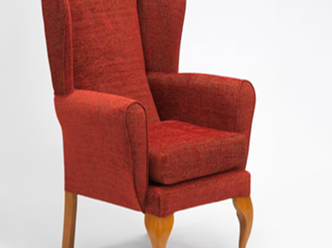
Listening Chair Research Aims?
Listen to experiences and ideas of frontline care home staff about staff retention and wellbeing at work (photovoice)
Share feedback of findings and engage care home staff in quality improvement activity
Co-design and facilitate implementation of sustainable best practice to improve staff retention and wellbeing at work.
Identify how to support and deliver sustainable quality improvements in participating care homes
Share findings across the sector

Slide 3
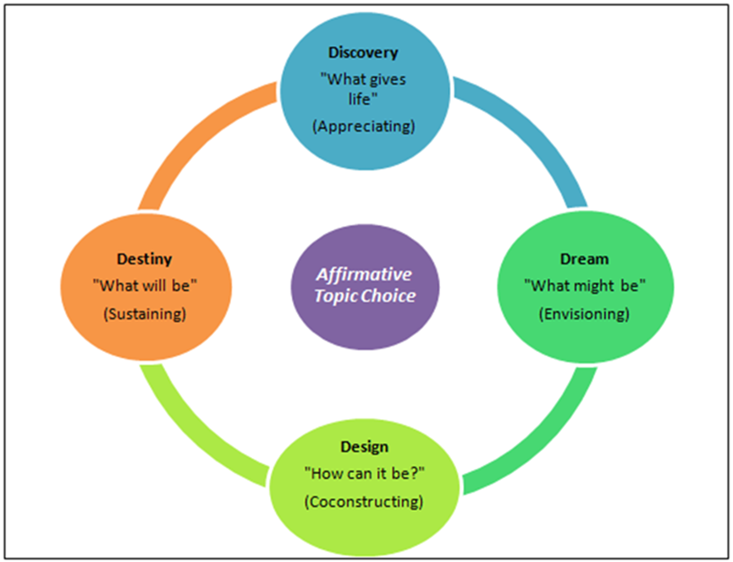
Listening CHAIR activities
An opportunity for Care Home staff to:
confidentially share views and experiences of staff wellbeing and retention at work
listen to experiences and insights from frontline staff
support the implementation of sustainable best practice through facilitated quality improvement activity

Slide 4
Listening Chair Methods
Interviews and focus groups (day and night shifts)
Care home staff invited
Use of photovoice ‘Envision cards’
Following Appreciative Inquiry approach
Two researchers present at each interview / focus group (facilitator and scribe)
Data analysis - Reflexive Thematic Analysis and Interpretive Description
Two guiding questions -
What supports your wellbeing at work?
What keeps you working in this Care Home?

Slide 5
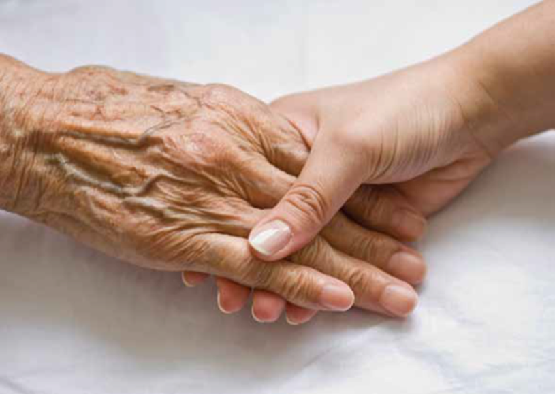

Slide 6
Participants - Interviews and focus groups in 10 care homes
 | n | %
Care Assistant/Worker | 59 | 47
Domestic/Laundry/Kitchen Staff | 16 | 13
Activities/Social Staff | 14 | 11
Senior Care Worker/Team Leader | 12 | 10
Care Home Support Staff | 10 | 8
Nurse | 9 | 7
Management Staff | 6 | 5
 | 126

Slide 7
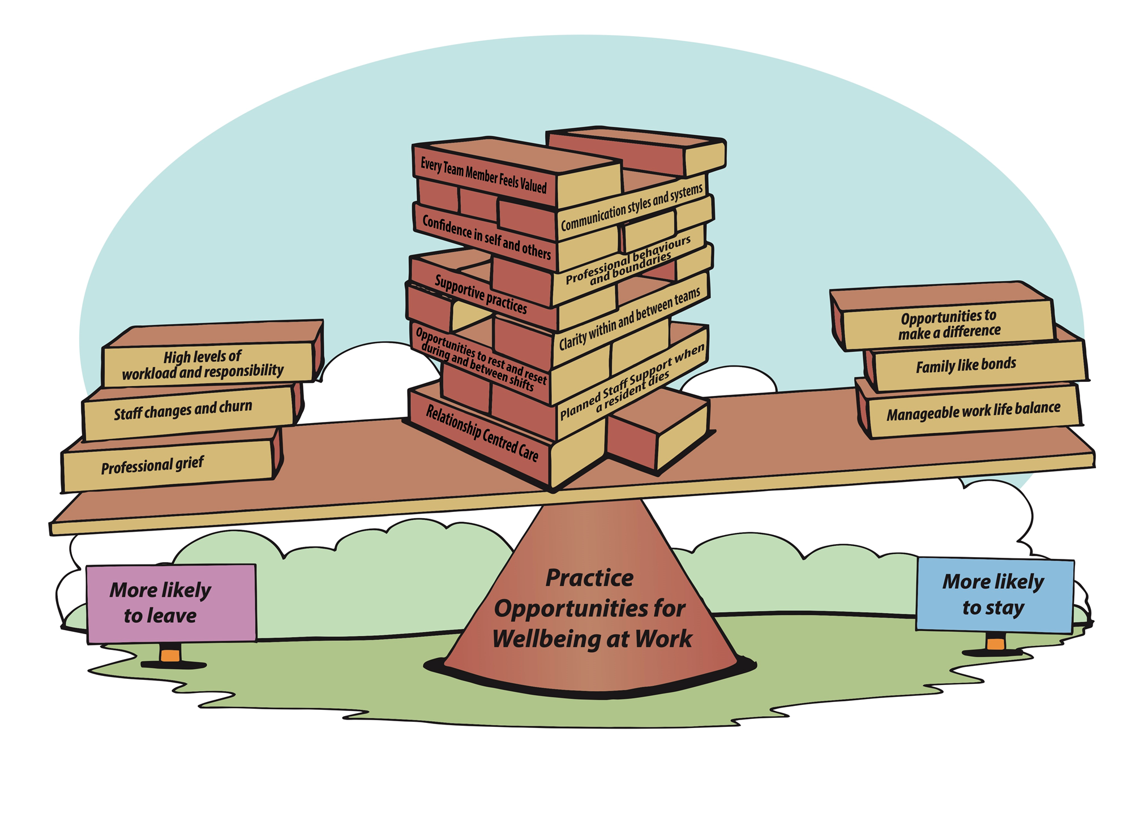
A see - saw approach to retention and wellbeing at work

Slide 8
Interesting things to ponder …..
Ensuring data analysis and findings are accessible to care home staff, and bespoke to each care home
Translating findings into potential practice opportunities
The power of relationships and relationship centred care in a care home community
The value of photovoice methods – chance to talk and ‘feeling heard’
Combining Appreciative Inquiry and Quality Improvement methodologies
Partnership working with NHS Lothian’s Care Academy and Care Home Quality Improvement Teams to develop and embed improvement

Slide 9
Workshop Activity Think about retention and wellbeing at work and in your groups :
Prioritise 3 bricks that represent relevant topics to you and arrange them on the seesaw.
Why have you chosen these 3 bricks?
What practice opportunities could they present in your setting ?
Feedback any thoughts on your group discussion to the room.

